Slide 1
Bricklayer Presentation
Diego Vazquez

Slide 2
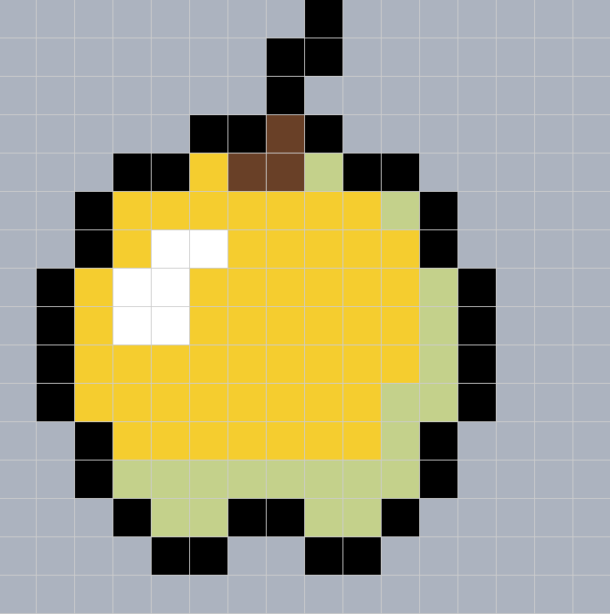
Pixel Art
One by one clicking in the Grid a lot time consuming than Bricklayer

Slide 3
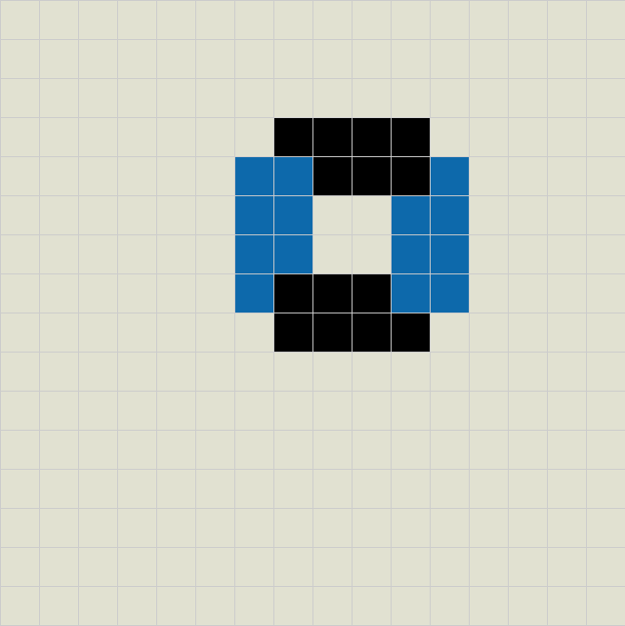
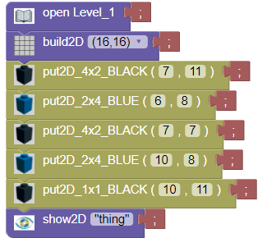
Saving in Bricklayer

Slide 4
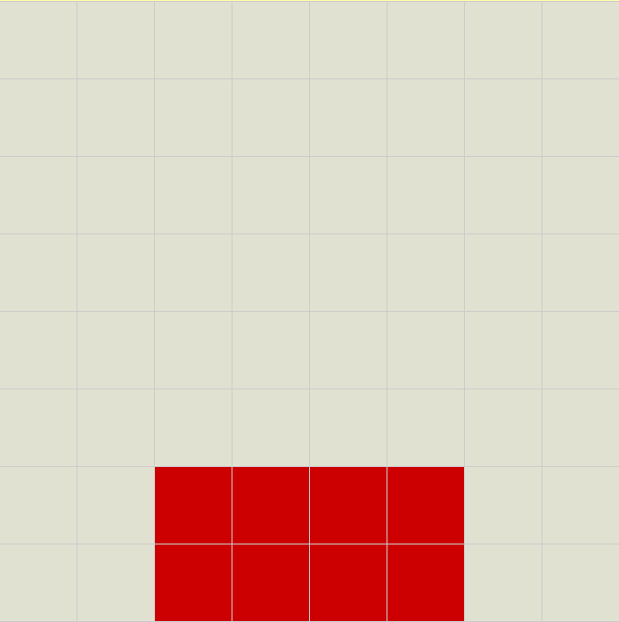
Objects in Bricklayer
We created a basic 2x4 Square in Bricklayer to begin

Slide 5
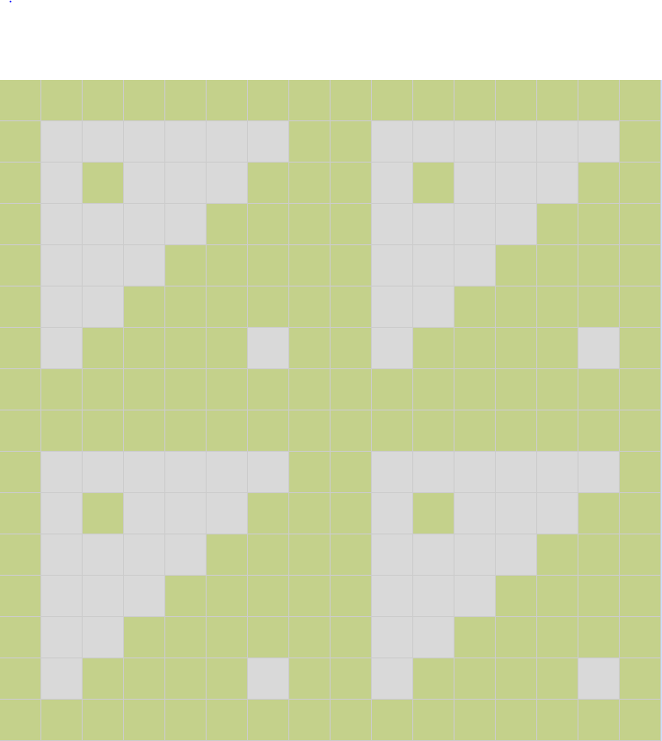
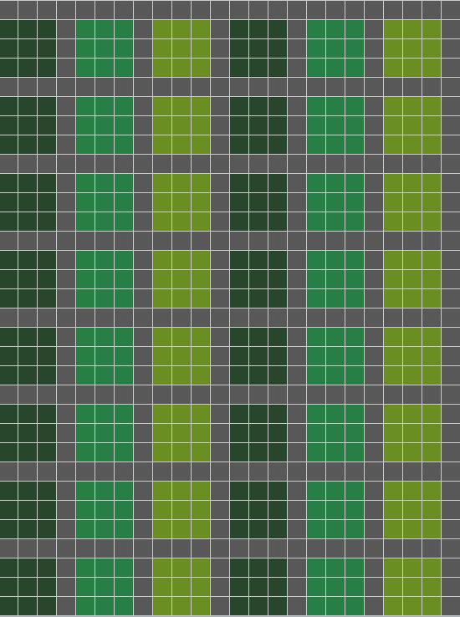
Objects around Bryan High
Library Tiles on Left
Bathroom Tiles on Right

Slide 6
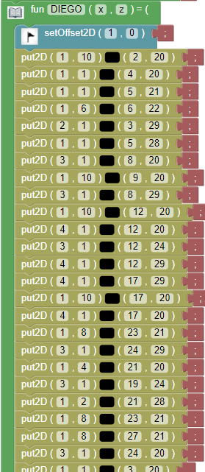
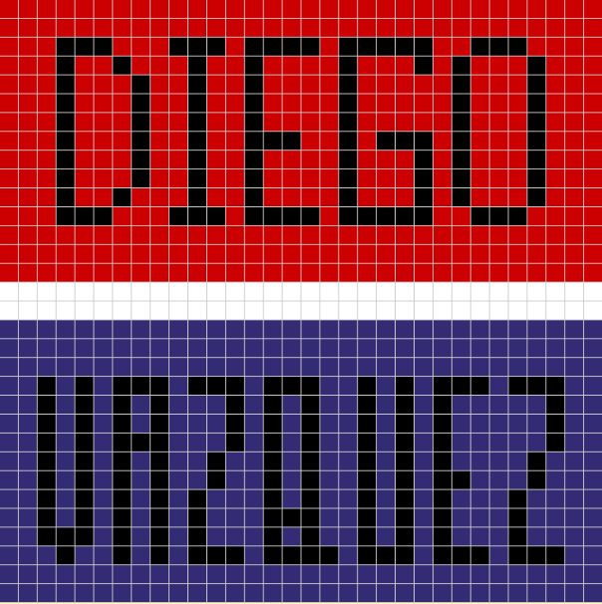
Name Project

Slide 7
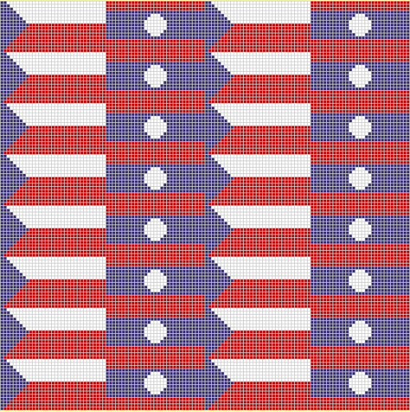
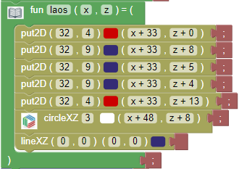

Flag Project
I made the flag of the Czech Republic and Laos for this project.

Slide 8
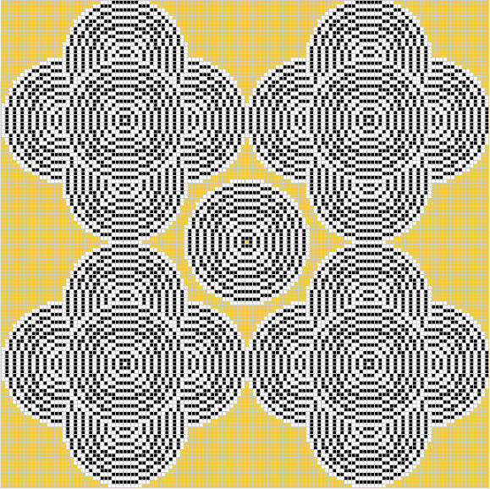
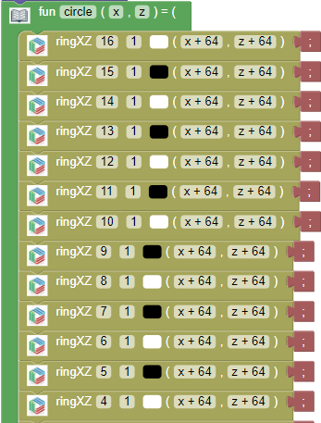
Ring Circle Patterns
Just a bunch of rings repeated everywhere.

Slide 9
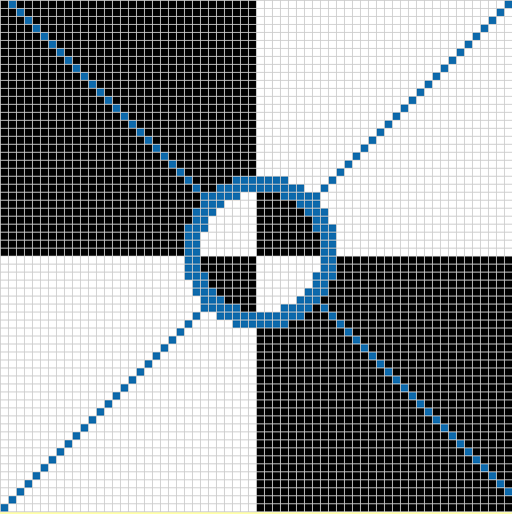
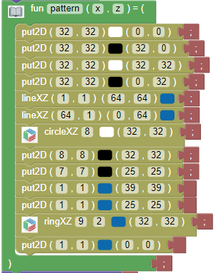
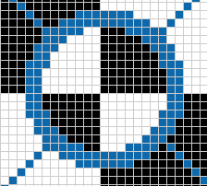
All Functions

Slide 10
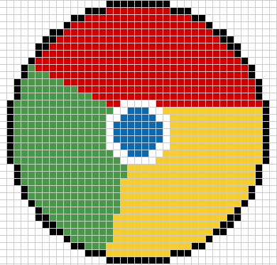
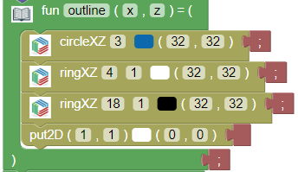

Real Image
In this project I decided to do the Google Chrome logo. Making this logo was quite a challenge filling up the circle with the colors.
The bottom picture shows how I made the simple circle in the middle.

Slide 11
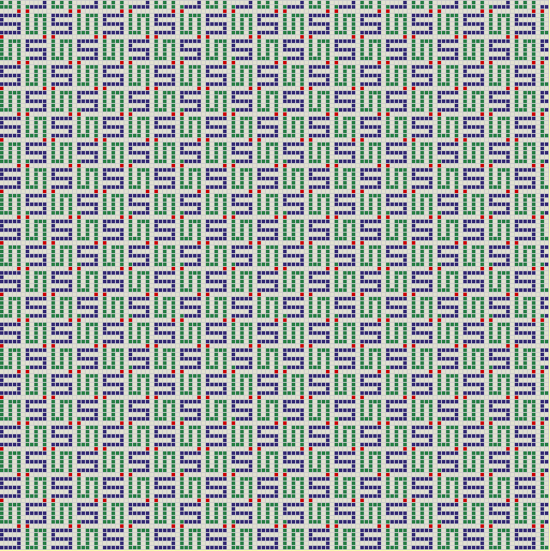
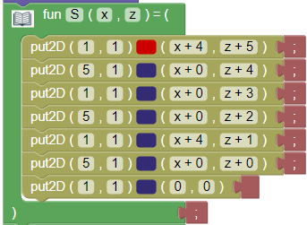
Space Filling Curves
In this project we created an “S” that continually repeated across the whole 128x128 grid.
In the screenshot below is the “code” for creating that one singular S.

